Slide 1
SlowFast-Vgen
Slow-Fast Learning for Action-Conditioned Long Video Generation
Workshop on Generative Models for Computer Vision, CVPR 2025
Yining Hong¹
Beide Liu¹
Maxine Wu¹
Yuanhao Zhai³
Kai-Wei Chang¹
Linjie Li²
Kevin Lin²
Chung-Ching Lin²
Jianfeng Wang²
Zhengyuan Yang^{2,⧺}
Yingnian Wu^{1,⧺}
Lijuan Wang^{2,⧺}
¹ UCLA ² Microsoft Research ³ State University of New York at Buffalo
⧺ Equal Advising

Slide 2
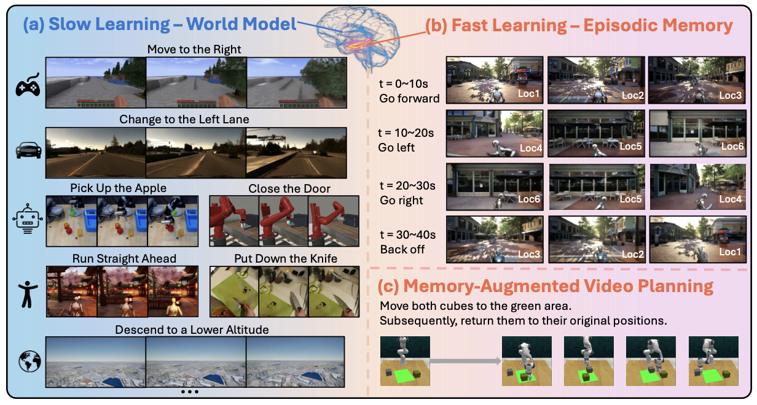

Slide 4
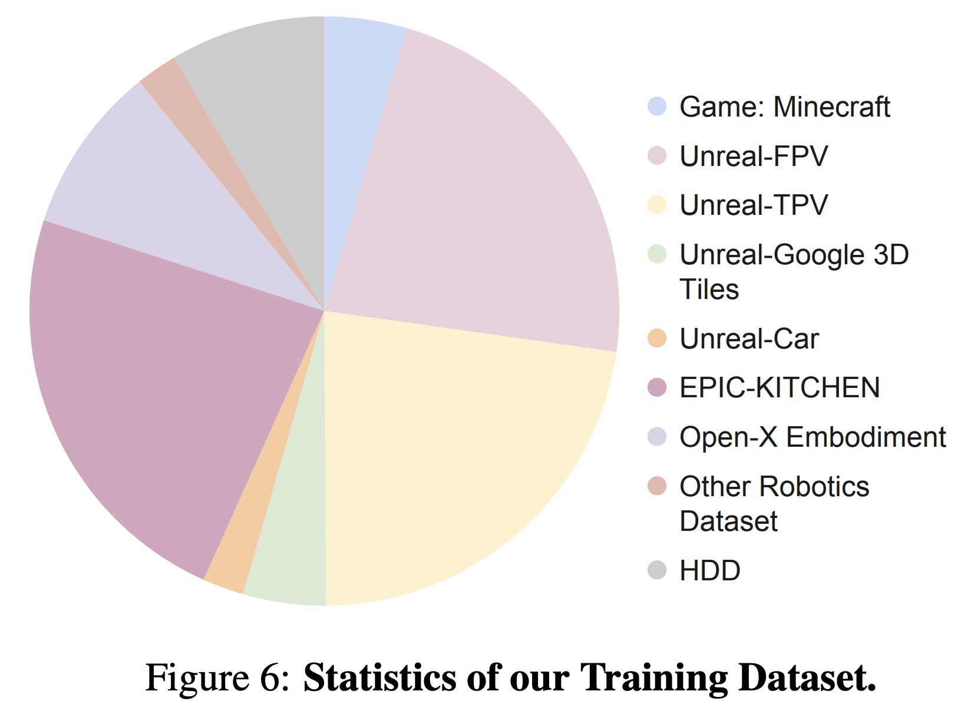

Slide 5
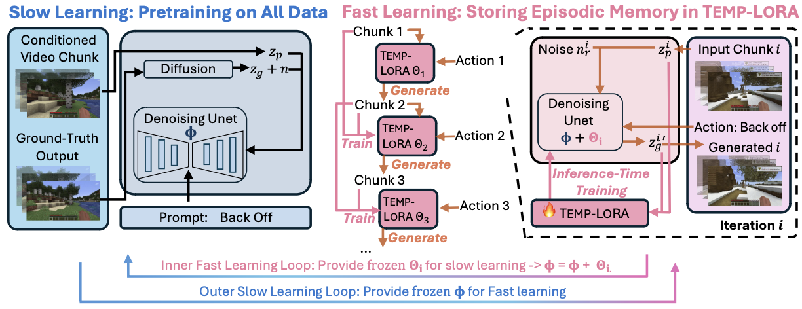
Fast learning: test-time instance-level fine-tuning for out-of-domain adaptation

Slide 8
Slow-Fast learning: slow learning supports fast learning adaptation, meta-learning

Slide 9
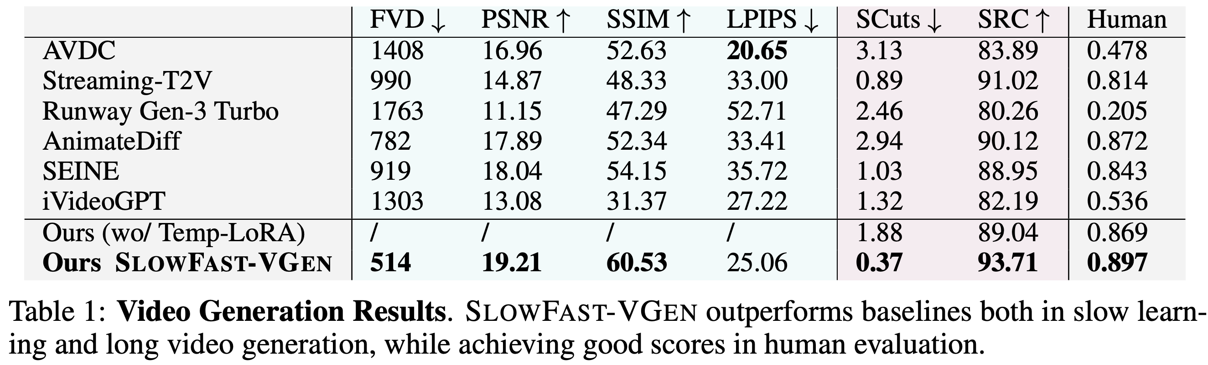

Slide 10
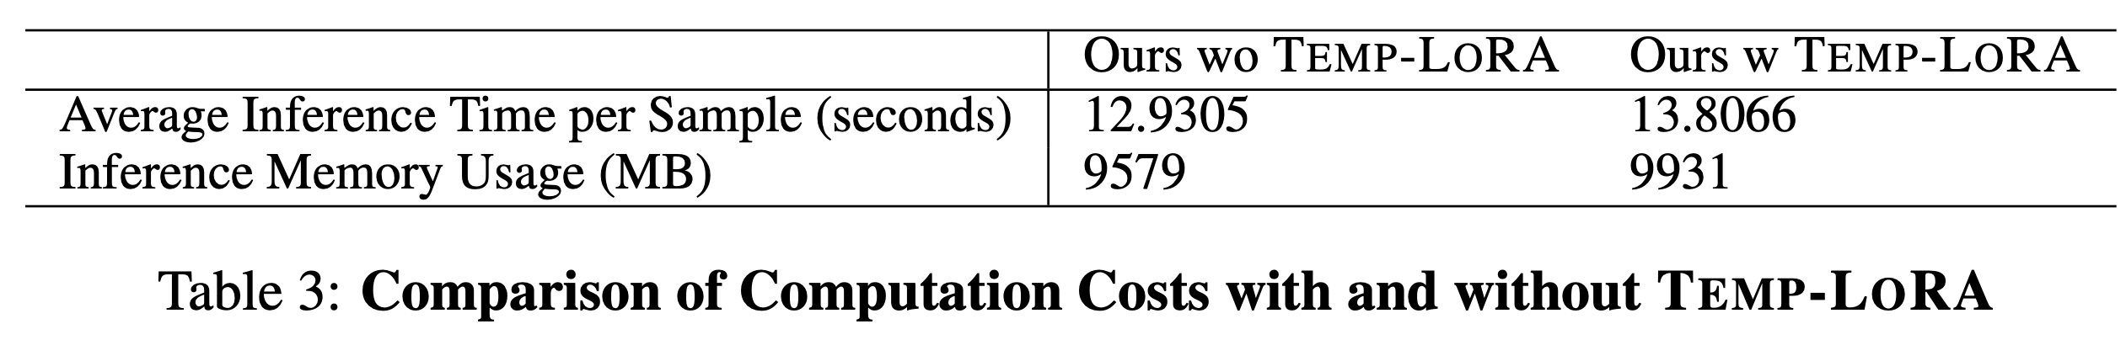

Slide 11
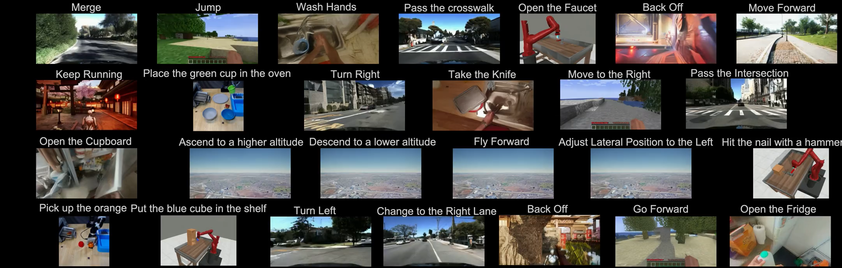

Slide 12
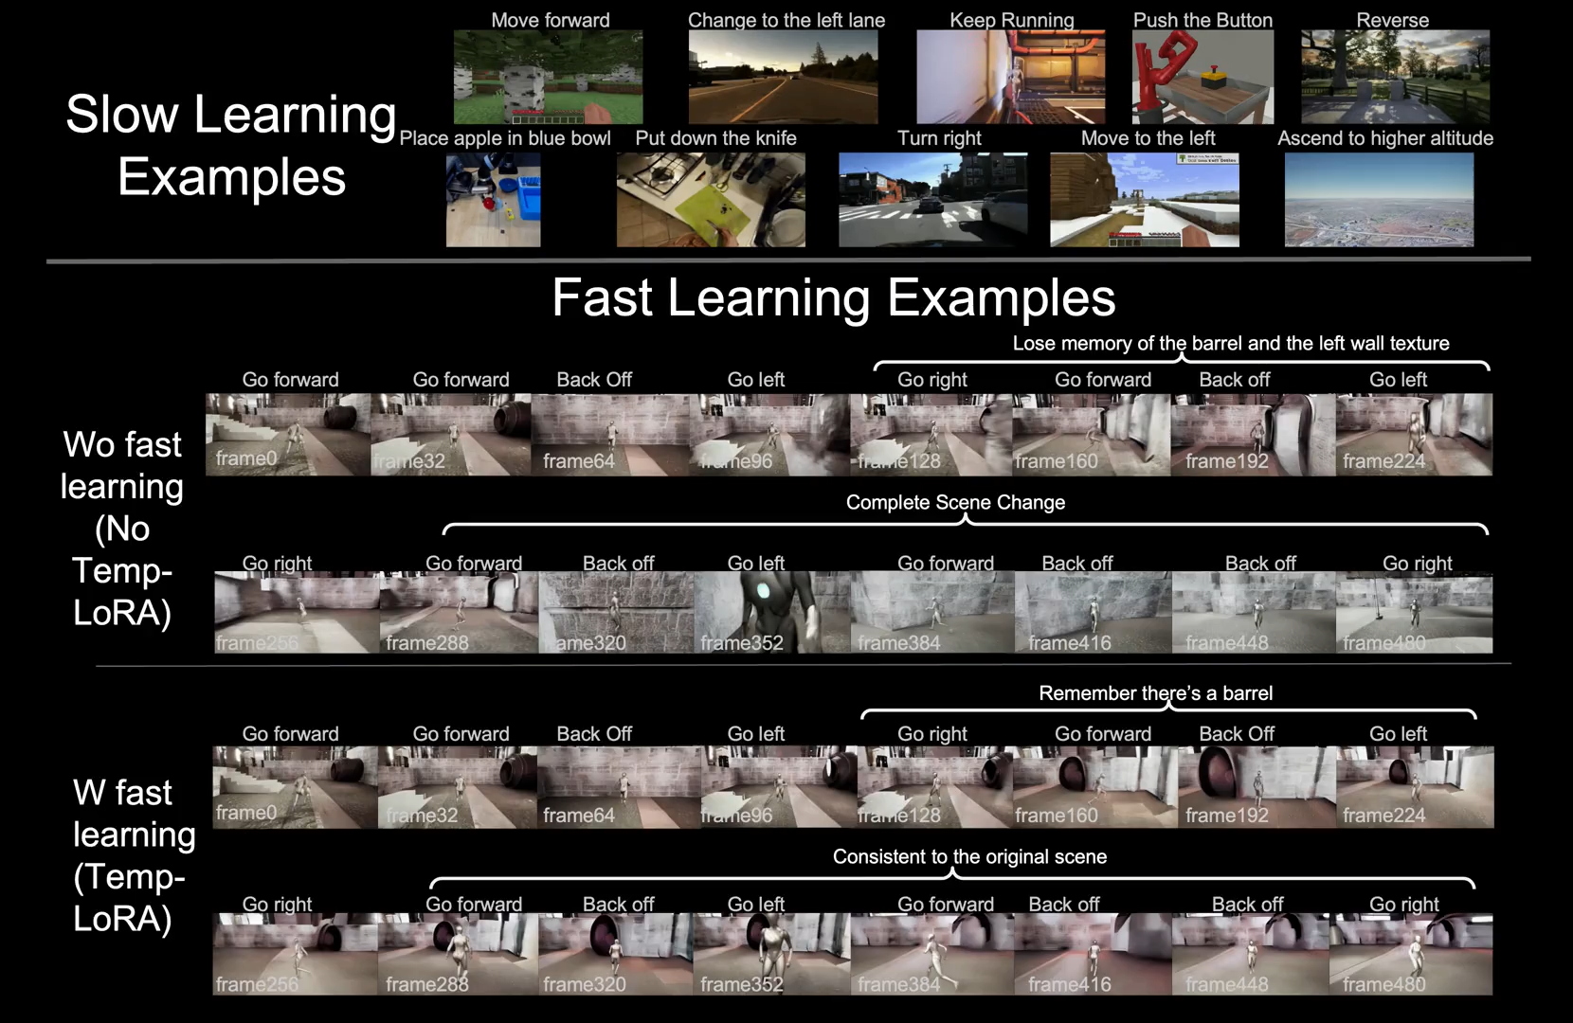

Slide 13
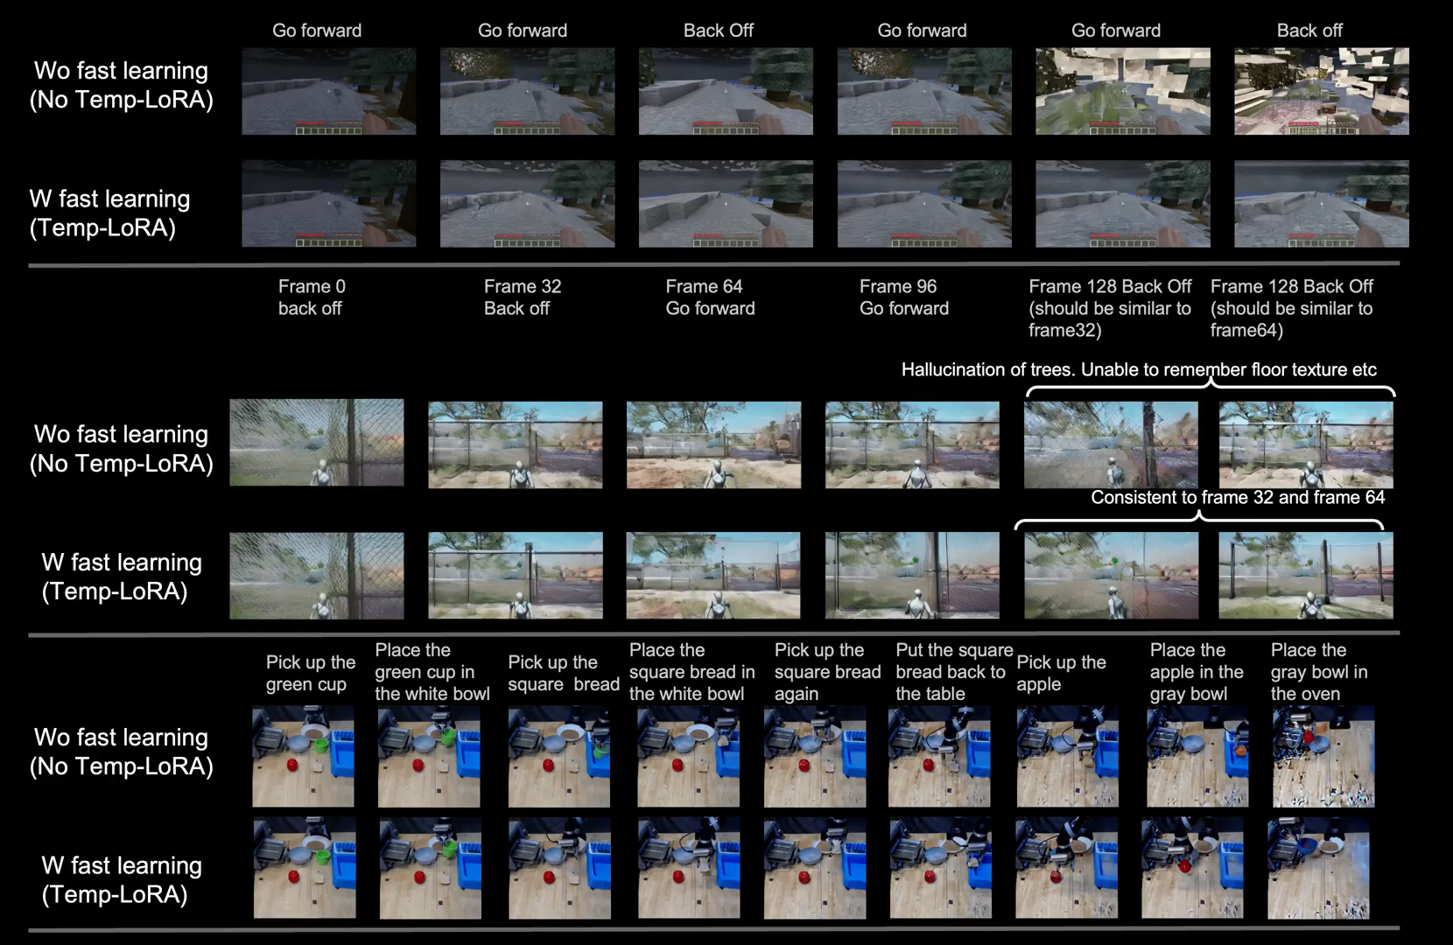

Slide 14
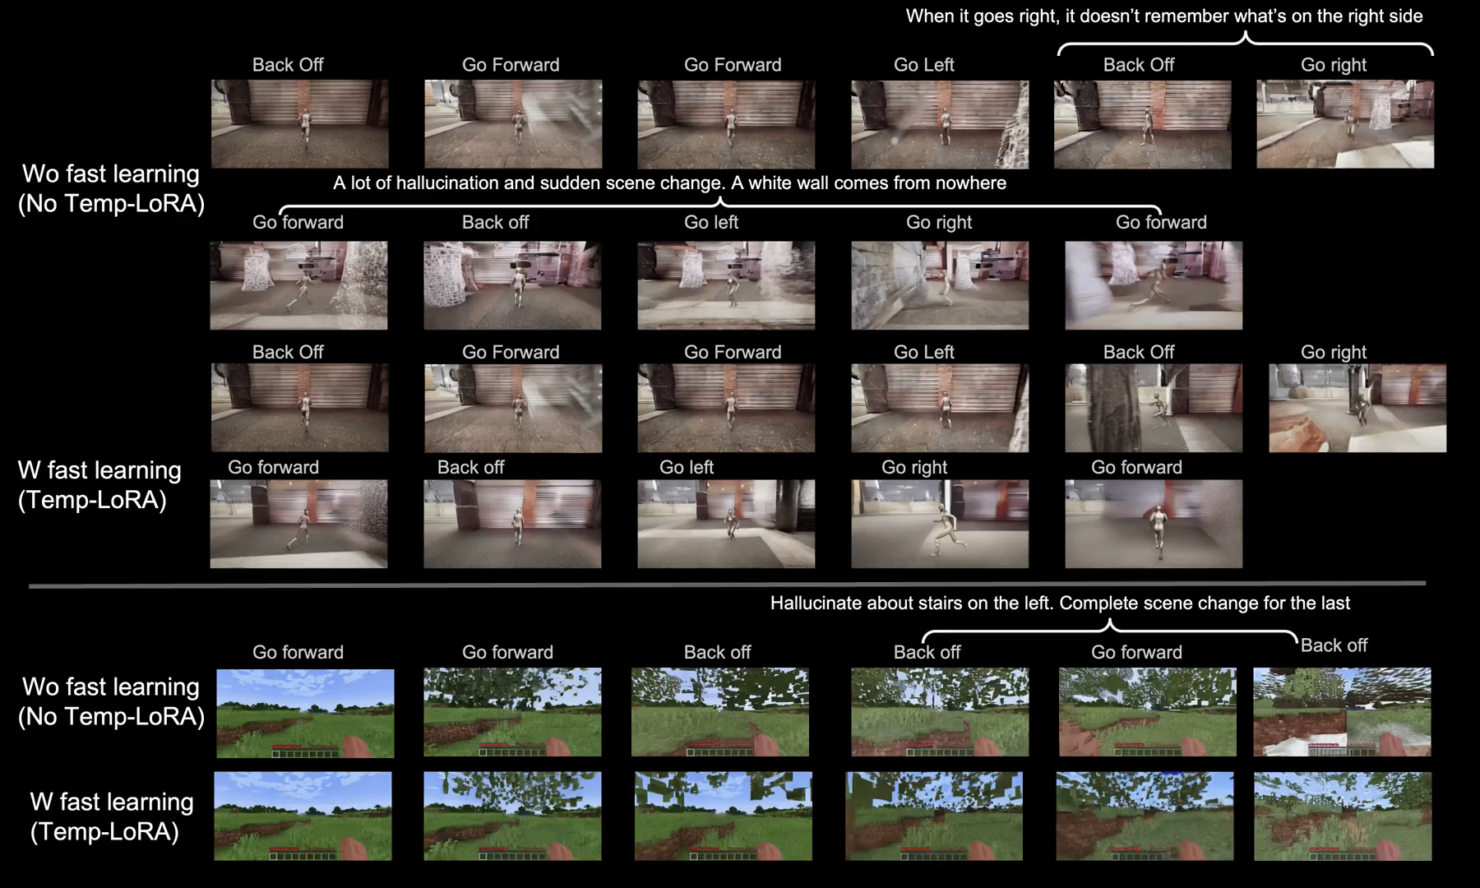

Slide 15
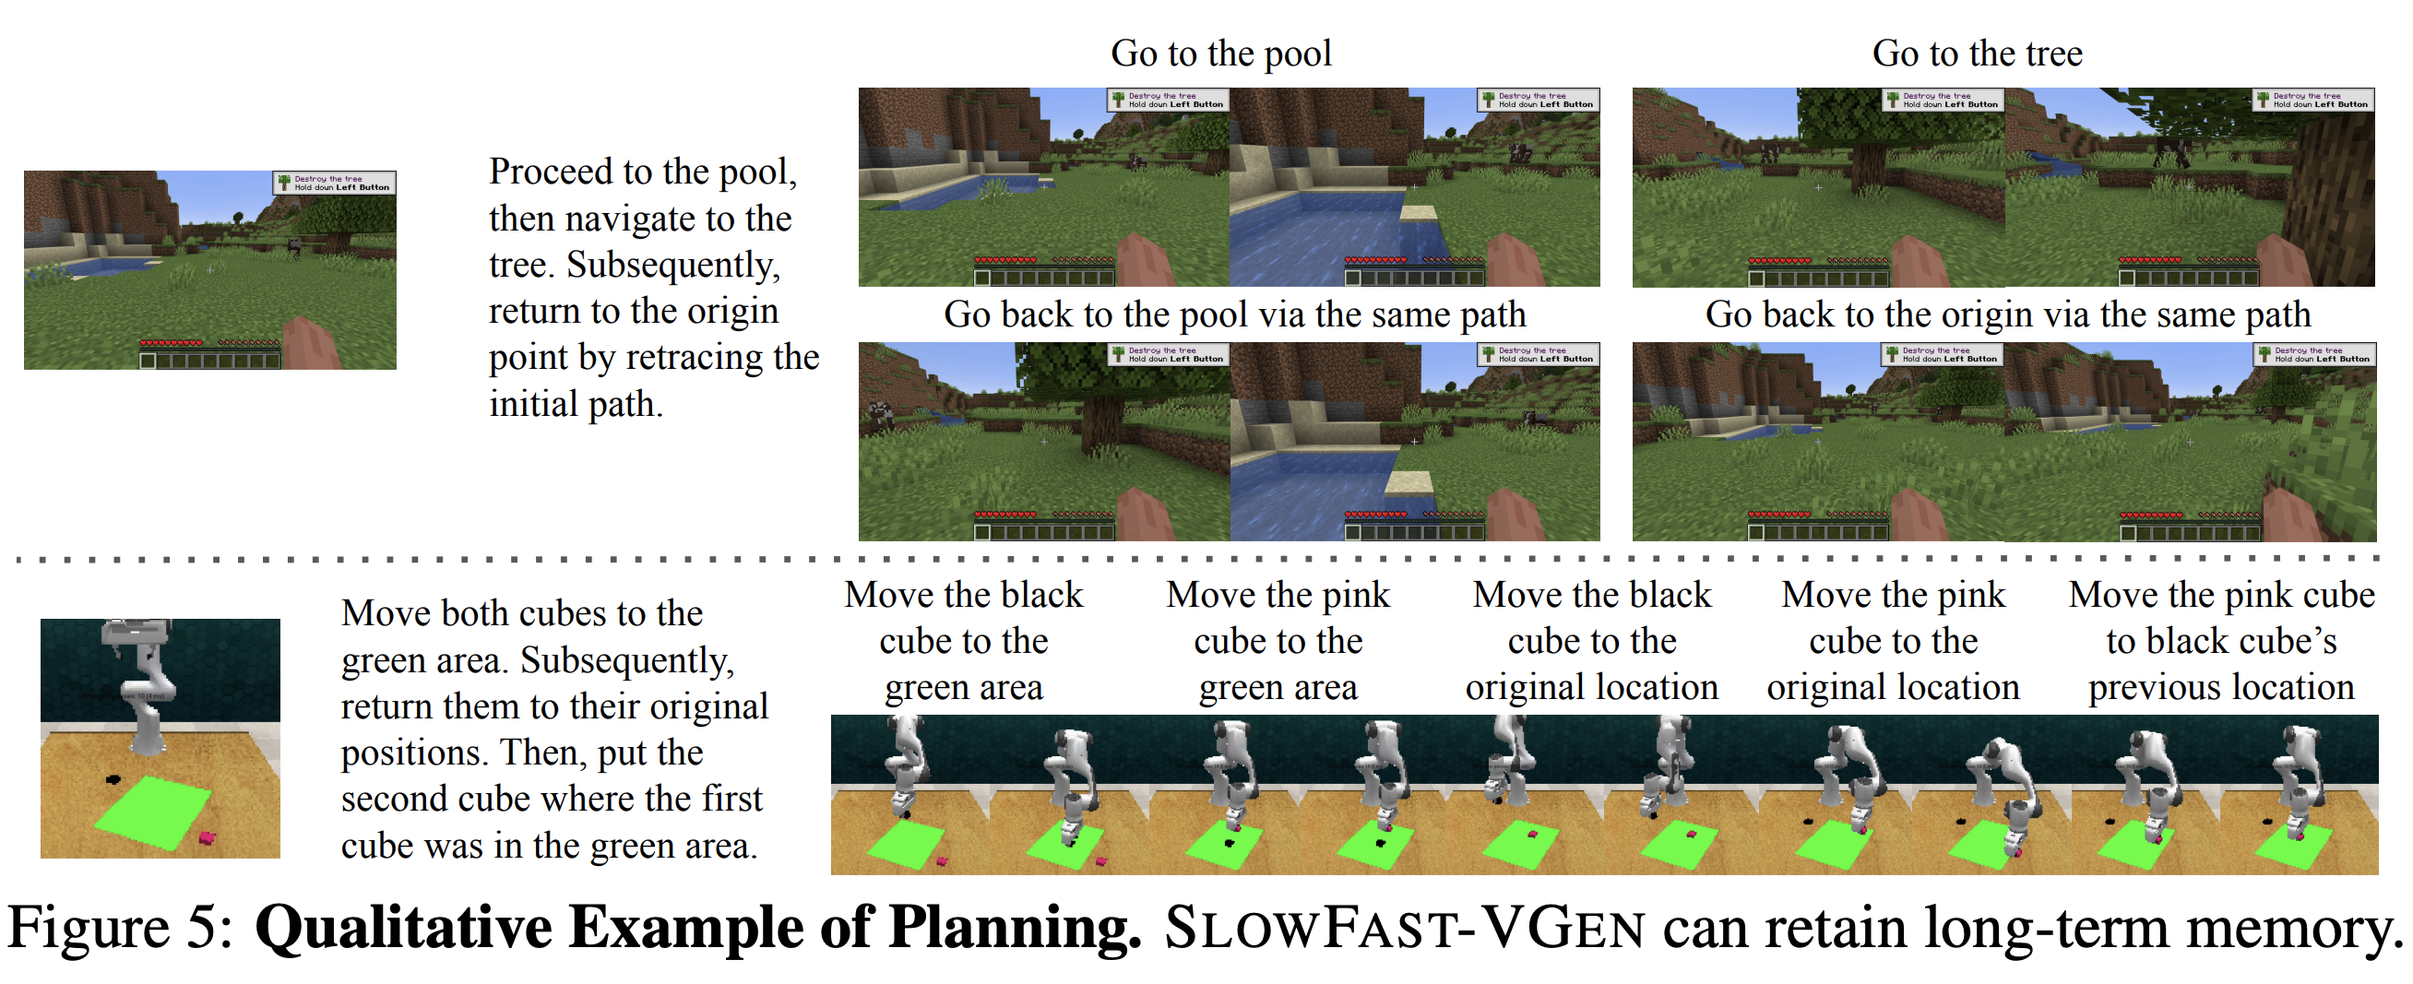

Slide 16
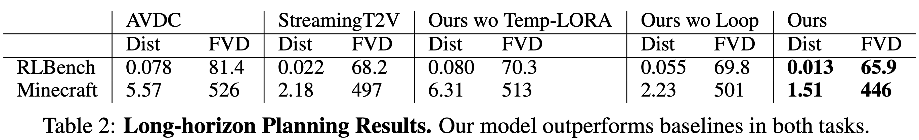

Slide 17


Video Navigation
Random walk
Goal Reaching

Slide 18
Broader Context: Generative Model for Computer Vision
Image and video generation, synthetic data
Model-based inference and learning→ 3D, object trajectories, cognitive map
Planning
Formulation: generative model
explicit latent variables.
explicit local parameters.
inference and learning based on generative likelihood (or surrogates)
planning guided by reward or value, instance-level test-time optimization.

Slide 19
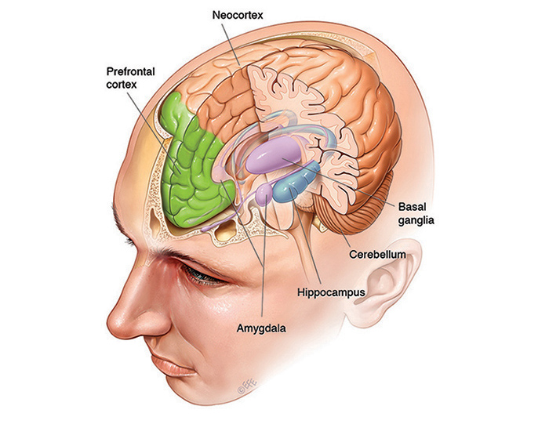
Broader Context: Computation at four different time scales
Reaction / reflex / feedforward / fast thinking S1
Planning / reasoning / latent variables / slow thinking S2 (prefrontal cortex)
Cognitive map / episodic memory / local parameters/ fast learning (hippocampus)
Long-term consolidation / global parameters / slow learning (neocortex)
Digital intelligence: learned implicit algorithm via ResNet
(1) as inference and (4) as learning
Cover (2) and (3): end-to-end ResNet as approximate short-cut
(2) Residual stream, (3) In-context learning
Biological intelligence: explicit algorithm for slow thinking and fast learning
more generalist and adaptive, less reliance on data size and quality
similar to fine-tuning → out of domain generalization
test-time, instance-level fine-tuning or adaptation

Slide 20
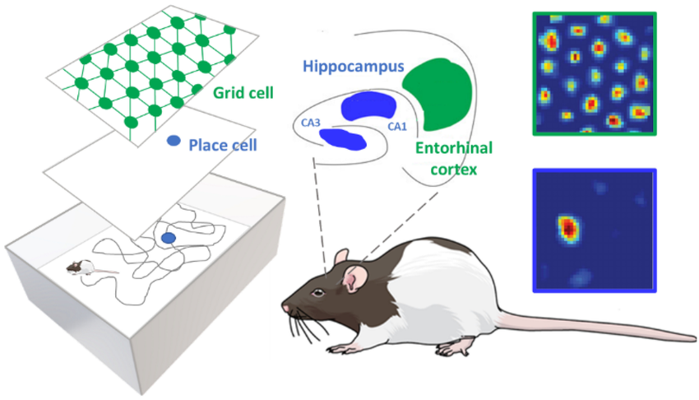
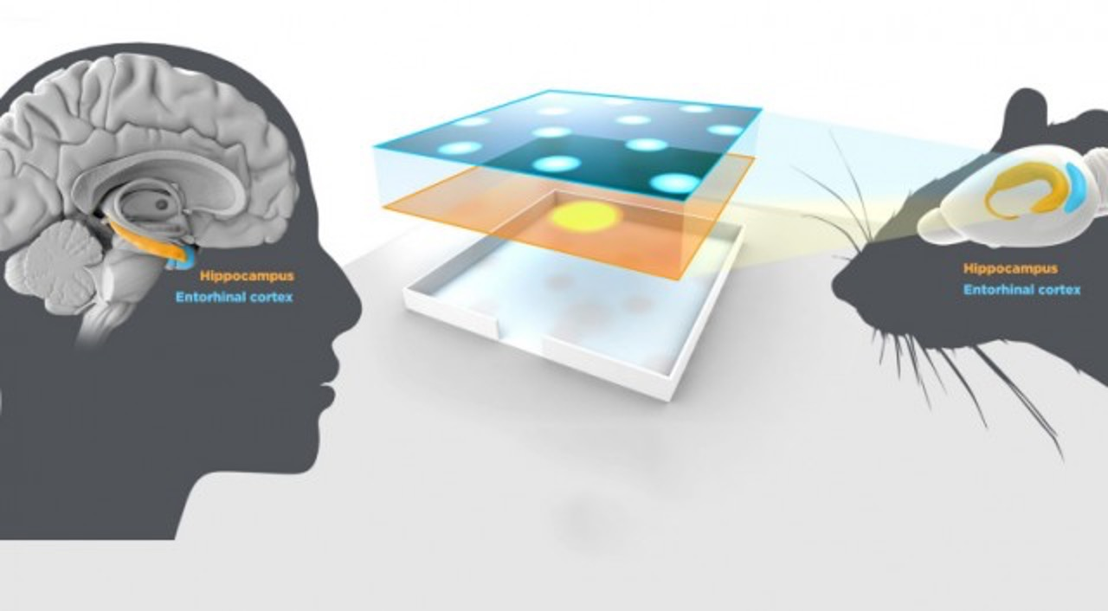
(2) Path planning / reasoning / slow thinking (prefrontal cortex)
(3) Cognitive map / episodic memory / fast learning (hippocampus)

Slide 22
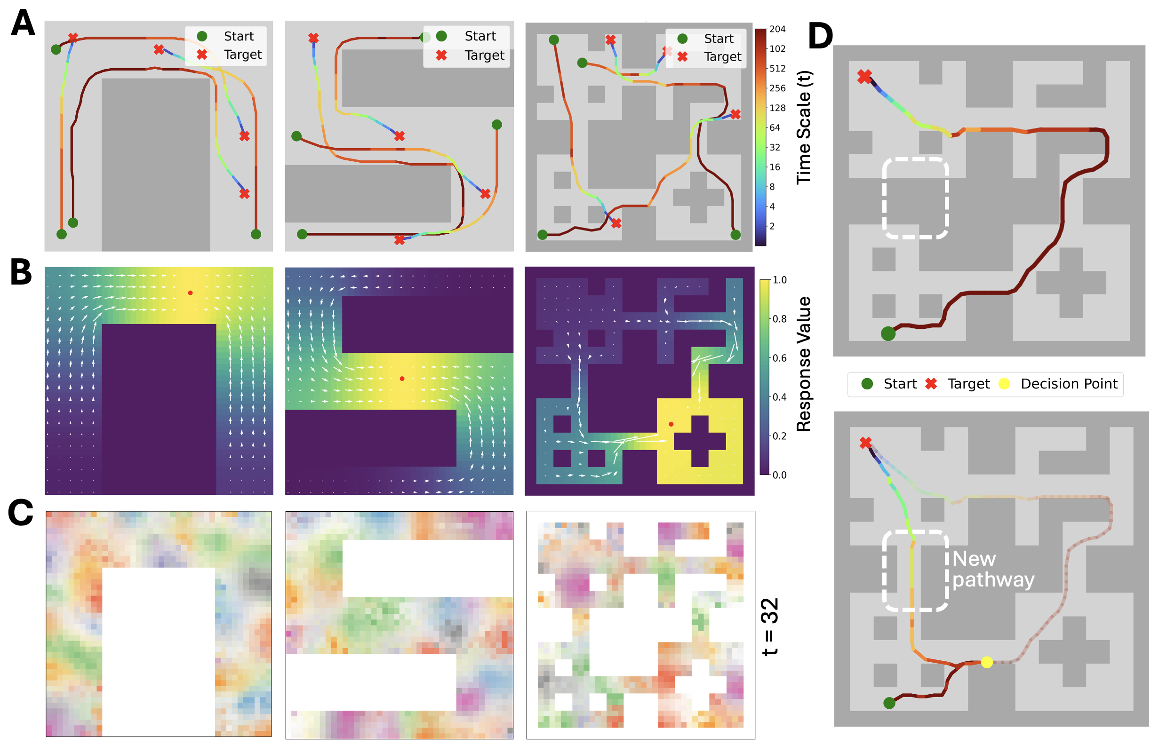
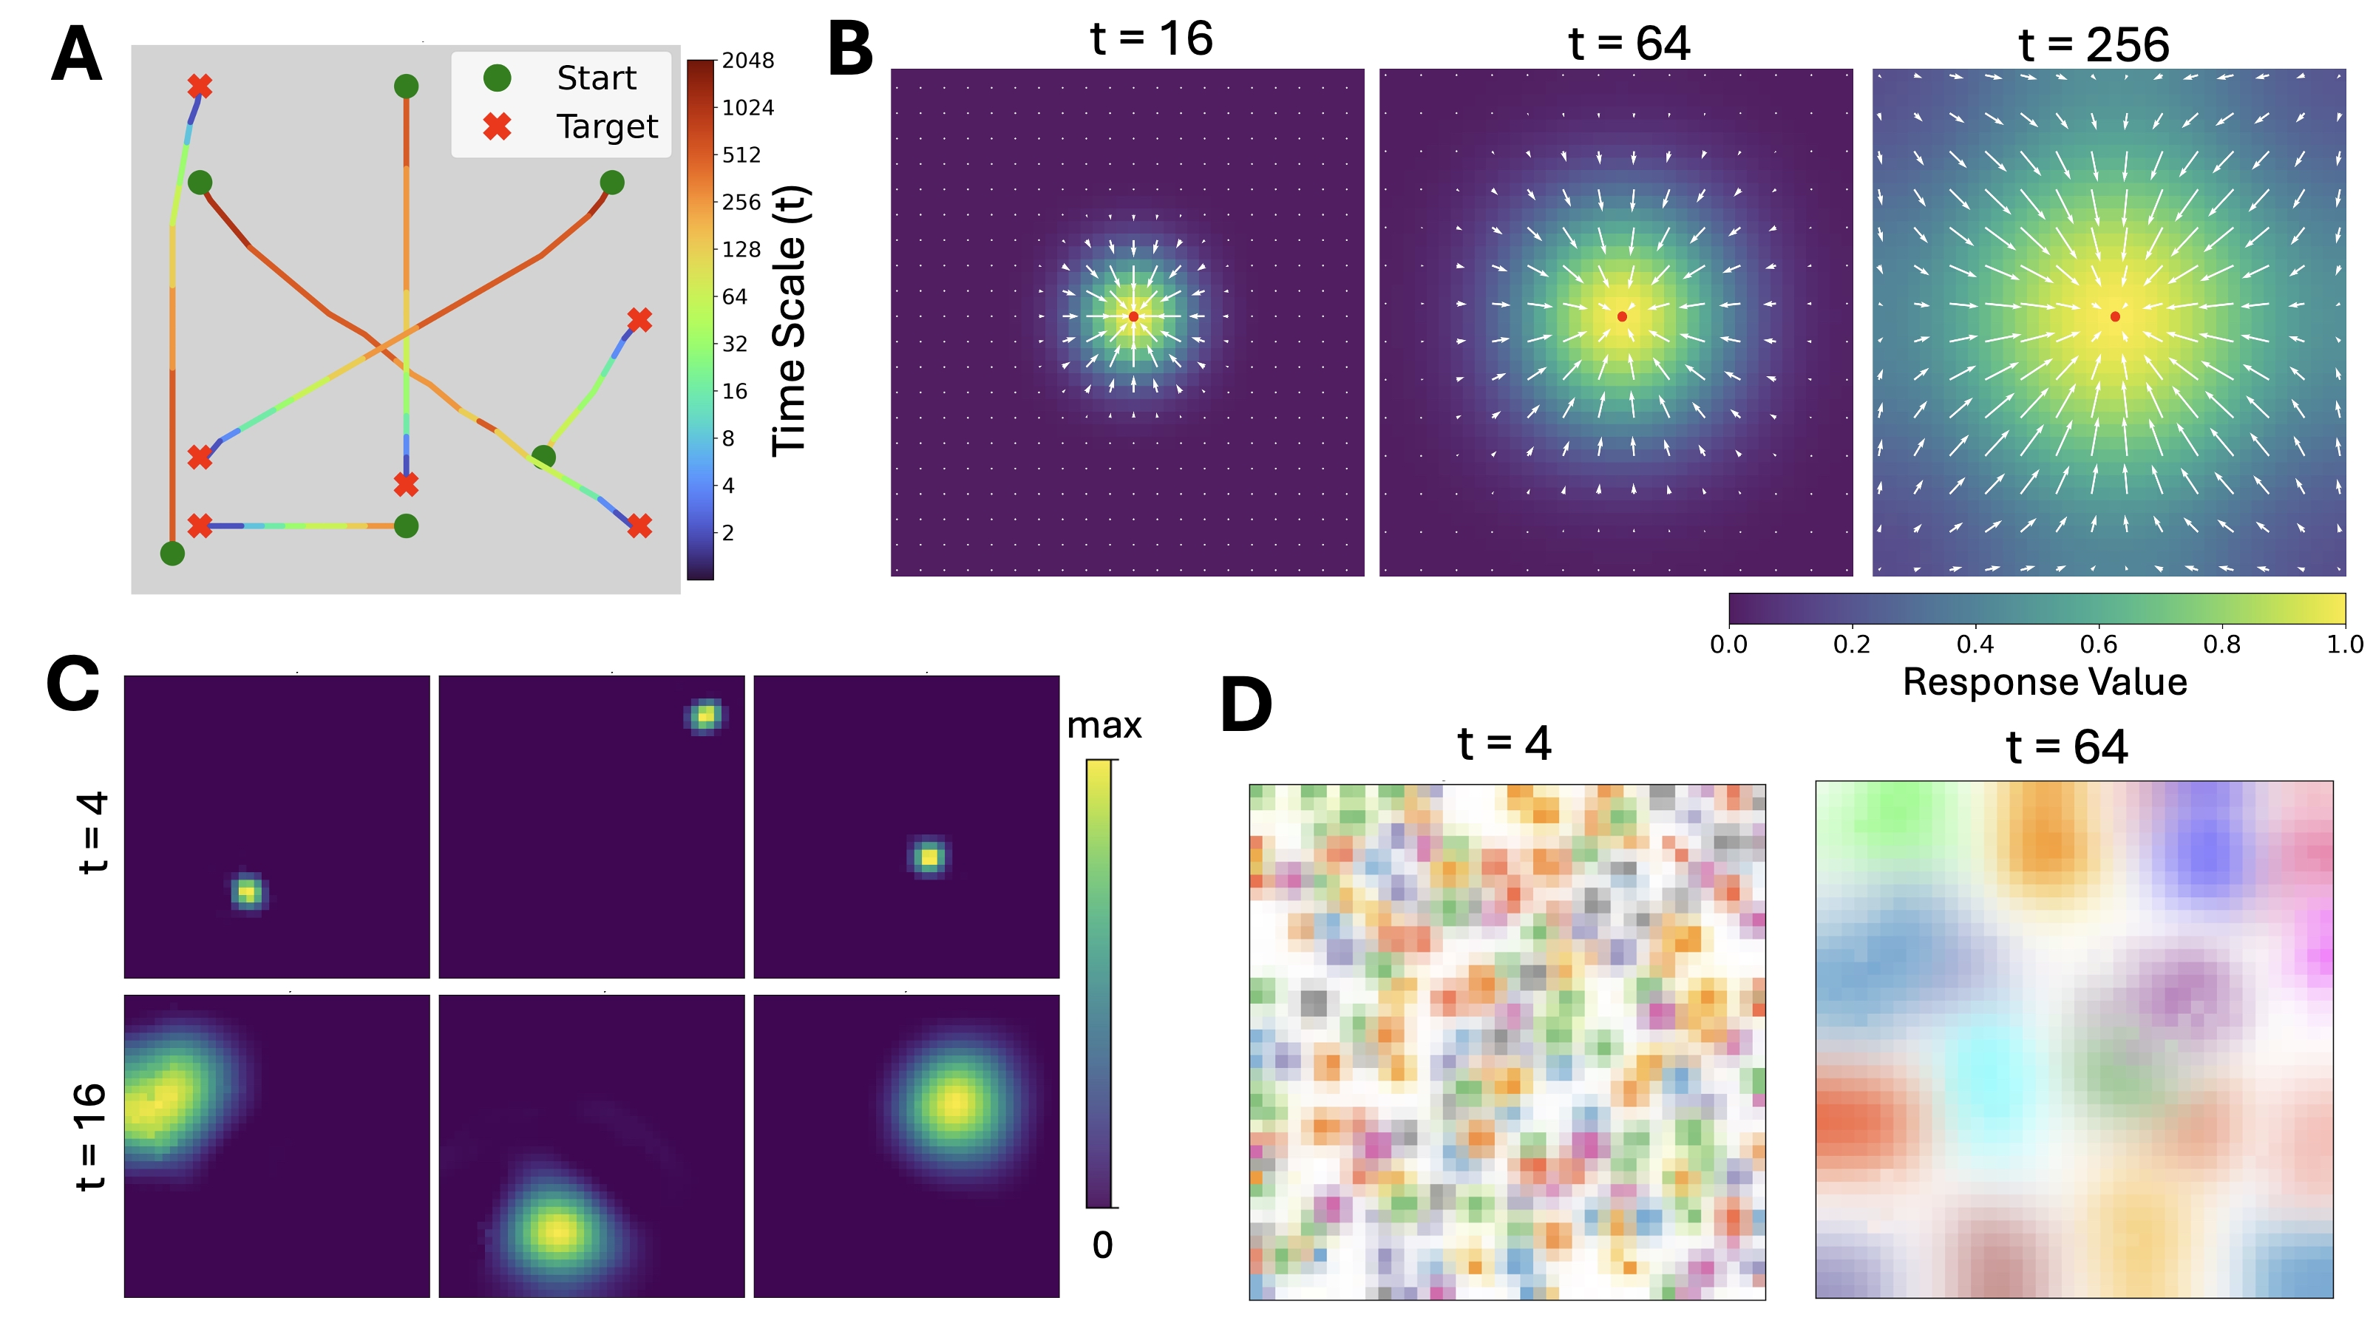
Place Cells: latent space preserving proximity p(y|x, t), straight-forward planning
Zhao, M*; Xu, D*; Kong, D*; Zhang, W-H; Wu, Y N (2025) Place Cells as Proximity-Preserving Embeddings: From Multi-Scale Random Walk to Straight-Forward Path Planning.

Slide 23
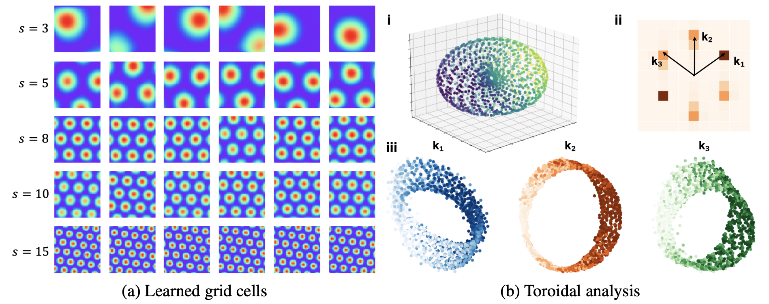
Grid Cells: latent space preserving distance, 2D coordinate / linear basis
h(x, t) = W(t) g(x)
Xu, D; Gao, R; Zhang, W-H; Wei, X-X; Wu, Y N (2025) On Conformal Isometry of Grid Cells: Learning Distance-Preserving Position Embedding. International Conference on Learning Representations (ICLR)

Slide 24
Video Navigation
Random walk
Goal Reaching

Slide 25
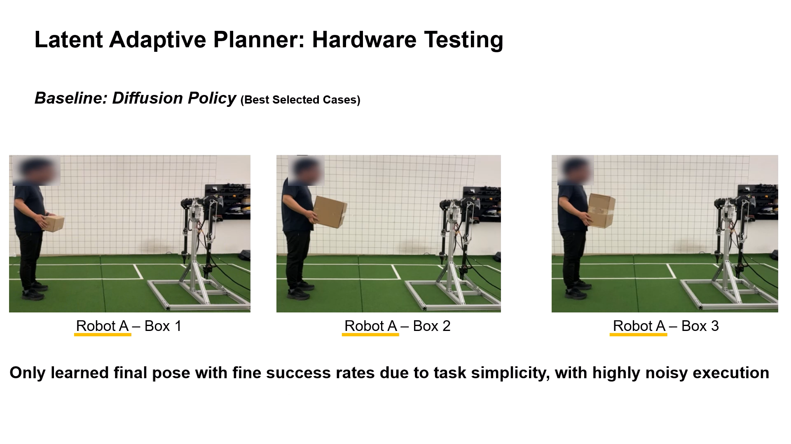
Latent Plan Models: planning = gradient in latent space
Noh, D*; Kong, D*; Zhao, M; Lizarraga, A; Xie, J; Wu, Y N^; Hong, D^ (2025) Latent Adaptive Planner for Dynamic Manipulation

Slide 26
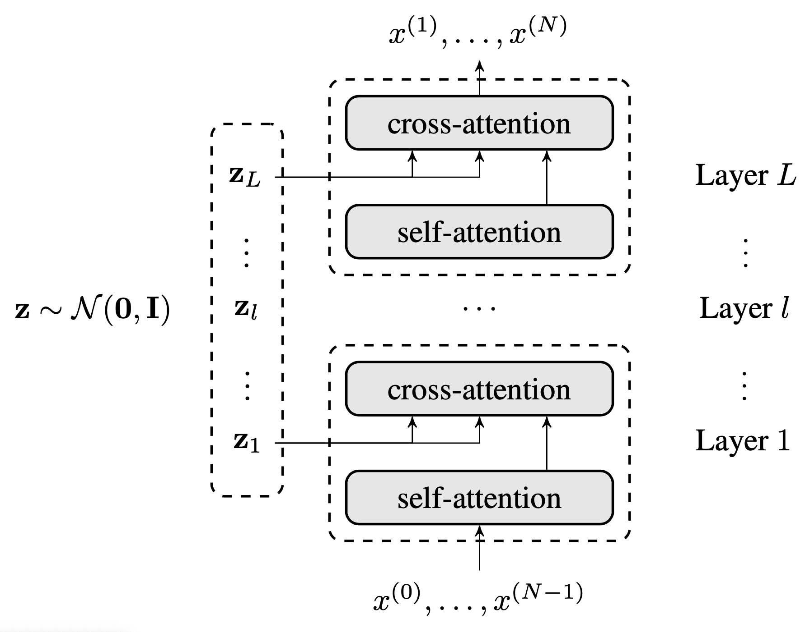
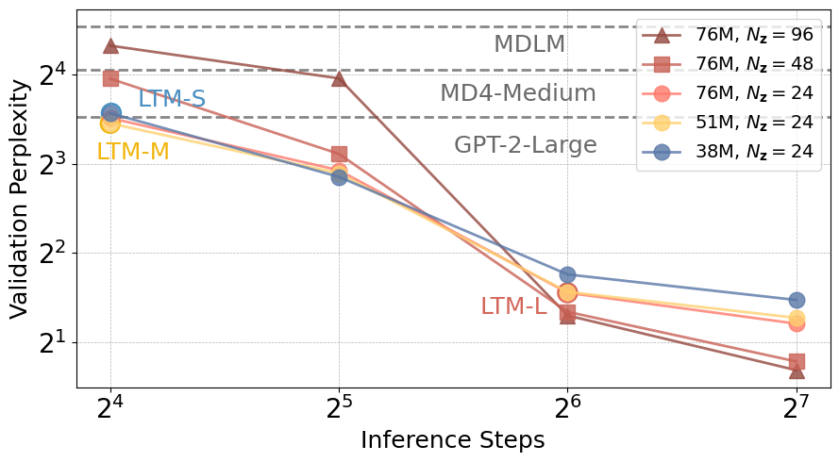
Latent Thought Language Models: reasoning = gradient in latent space
Kong, D*; Zhao, M*; Xu, D*; Pang, B; Wang, S; Honig, E; Si, Z; Li, C; Xie, J^; Xie, S^; Wu, Y N^ (2025) Latent Thought Models with Variational Bayes Inference Time Computation. International Conference on Machine Learning (ICML)

Slide 27
Generative Computer Vision with Computation at four different time scales
Reaction / reflex / feedforward / fast thinking S1
Planning / reasoning / latent variables/ slow thinking S2 (prefrontal cortex)
Cognitive map / episodic memory / local parameters /fast learning (hippocampus)
Long-term consolidation / global parameters / slow learning (neocortex)
Generative model for computer vision?
Learn a model (4) to support (1), with (2) and (3) hidden in residual stream.
vs
Learn a model (4) to support (1), and explicit (2) and (3) for out-of-domain adaptation.

